Slide 1

Smart Soccer Insights
By: Daniel Tshiani
DGT-International

Slide 2
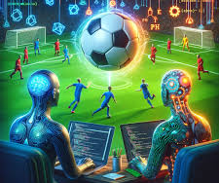
Table of Context
Motivation & Problem
Datasets Overview
System Pipeline
Object Detection
Player Tracking & Pitch Mapping
Results & Demonstrations
Limitations, Lessons Learned, Future Improvements
Conclusion

Slide 3

1. Motivation & Problem
“ We are missing out on a lot of clients because they don’t have GPS systems. Without player coordinate data, on-field positional analytics is complicated.”
– DSA Labs
+
DGT-International proposed to create a web app that reads soccer videos and extracts player coordinate data which can be used for further analytics.

Slide 4
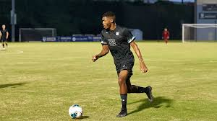

2. Data Overview
Bunndesliga Data
Jakub Michalczyk, Maggie, Mirko Janetzke, Moritz Michael Mücke, Ryan Holbrook, and Uwe Dick. DFL - Bundesliga Data Shootout. https://kaggle.com/competitions/dfl-bundesliga-data-shootout, 2022. Kaggle.
RoboFlow Data
Roboflow. (2025). Football-players-detection dataset [Open source dataset]. Roboflow Universe. https://universe.roboflow.com/roboflow-jvuqo-players-detection-3zvbc
DGT-International Custom Dataset
My old soccer videos

Slide 5
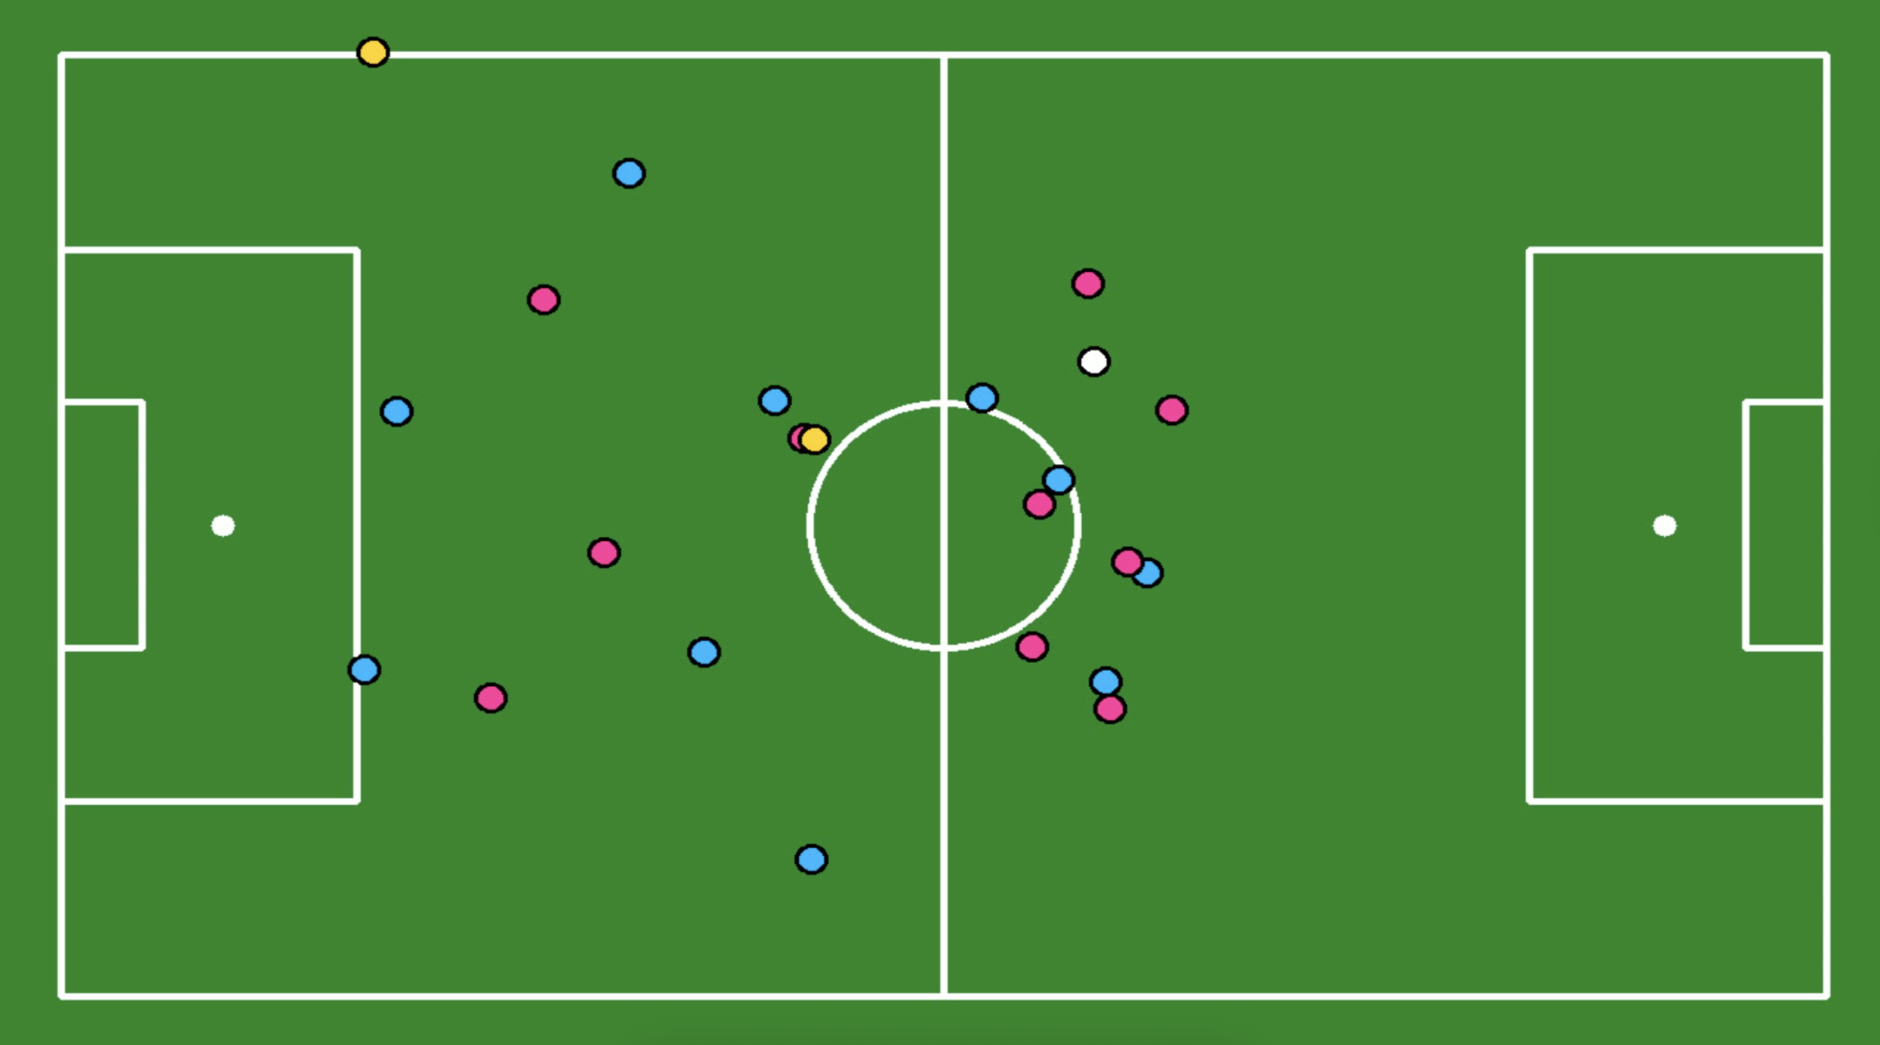
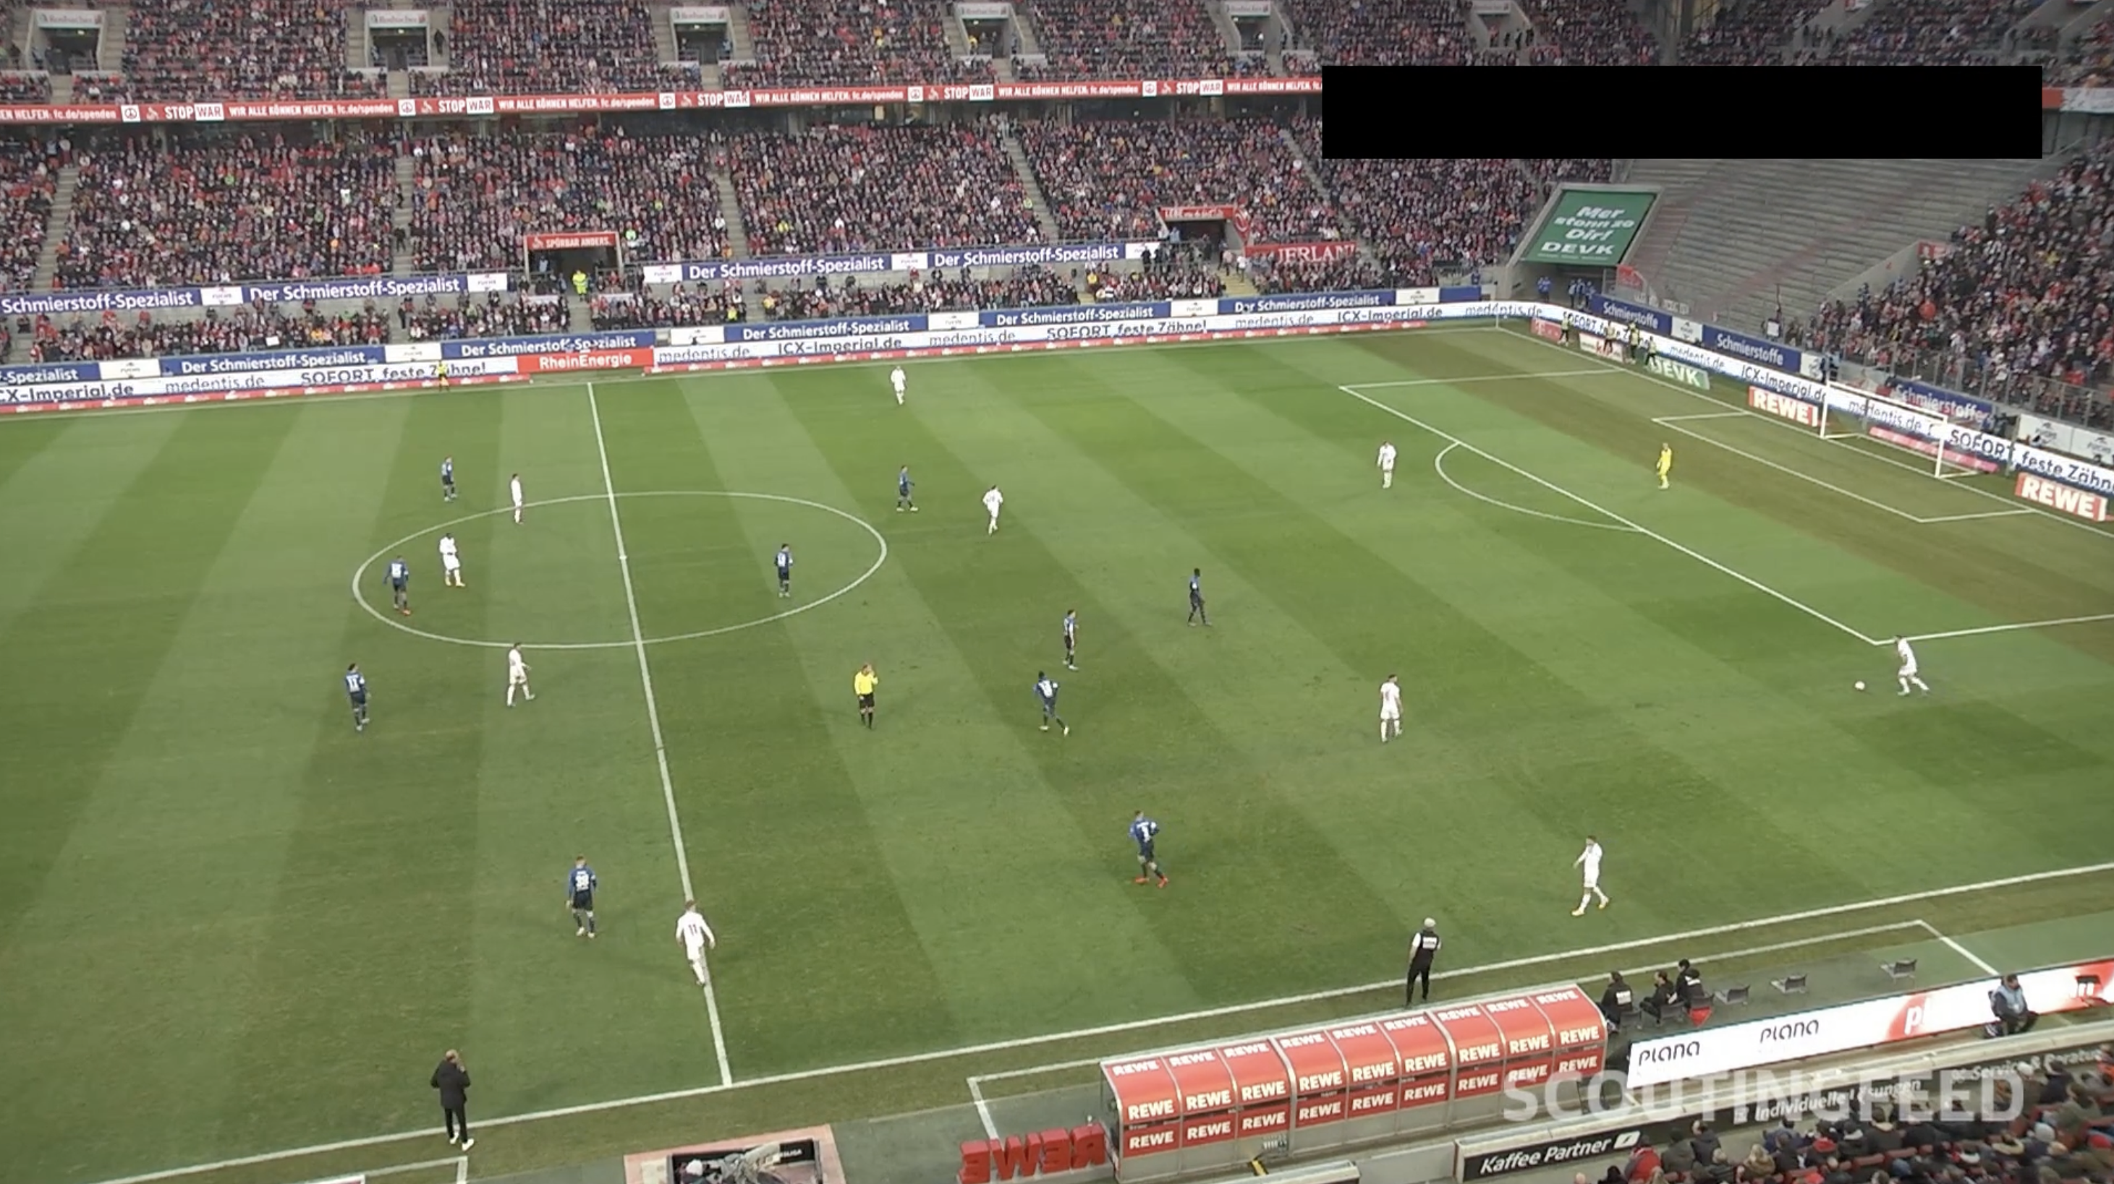
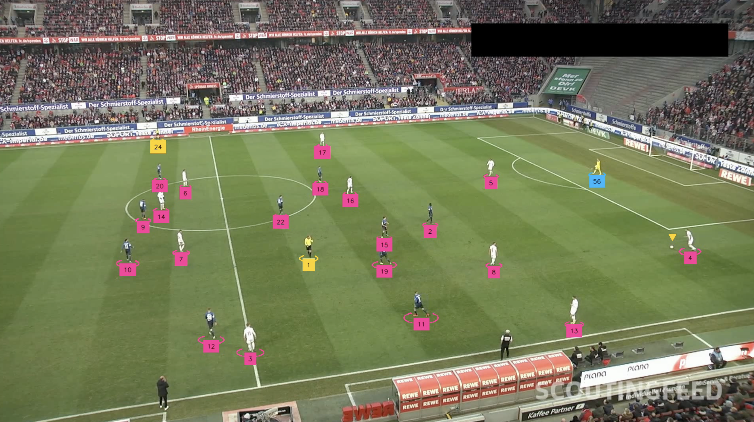
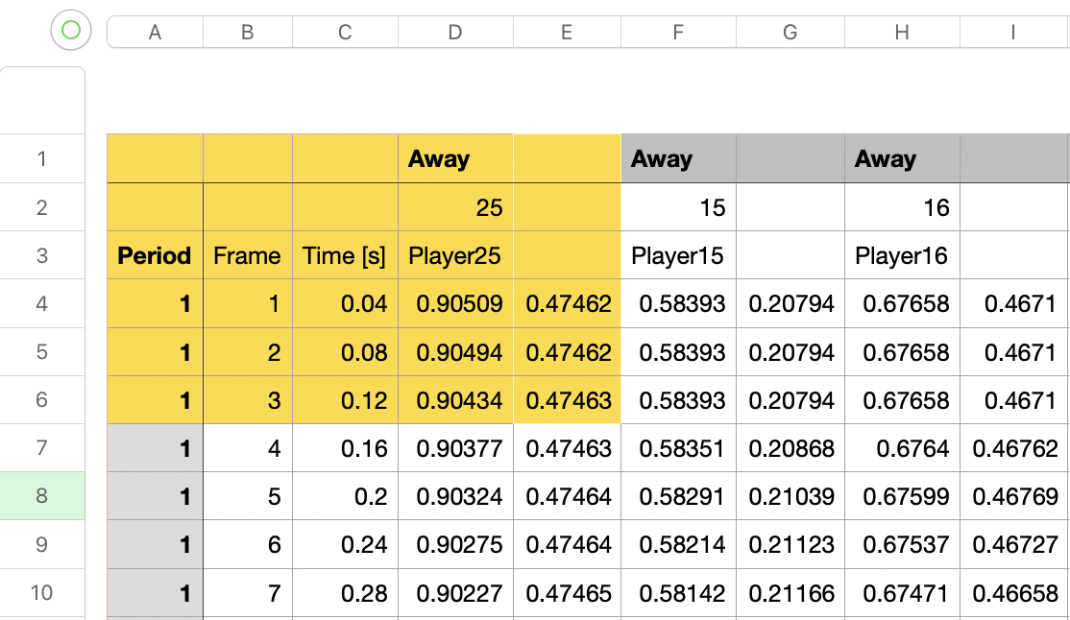
3. System Pipeline
User uploads video
Coordinates are extracted & mapped for visual confirmation
SSI Algorithm Analyzes it
Notes:
User uploads videos (box)
The algorithm analyzes it (line)
Players are detected and assigned IDs (box)
Tracking and coordinates extractions (line)
Map player position and output the coordinate data

Slide 6
4. Object Detection Architecture (part 1 of 5)
Yolov8s Model
Input Layer
Raw RBG videos
127 Hidden Layers
Convolutional
BatchNorm + activation
C2f /CSP Blocks
Down/Up Sampling
SPPF
Concat
~ 11M parameters
Output Layer
Players
Refs
Ball
Goalkeepers
Background
Notes:
The input layer is a convolution that takes in the raw RGB video frame. It converts the 3-channel image into the first 32 feature maps and prepares the image for deeper processing.”
1. Convolutional Layers — “extract visual features” “Convolutional layers are the core of the model. They scan the image and learn visual features — starting from edges and textures, and eventually full shapes like players.”
2. BatchNorm + Activation — “stabilize + enable complex learning” “Batch Normalization keeps the values in the network stable, and the activation function adds non-linearity. Together they help the model learn more complex patterns reliably.”
3. C2f / CSP Blocks — “efficient deep feature extraction” “These blocks are groups of smaller layers packaged together. They allow the model to learn deeper, richer features without becoming too slow or too large.”
4. Downsampling & Upsampling — “multi-scale understanding” “Downsampling reduces the resolution so the model can understand the big picture, while upsampling increases the resolution so it can detect small players.
5. SPPF — “global context extraction” “SPPF stands for Spatial Pyramid Pooling Fast. It helps the model capture global context — like understanding both close-up and far-away players in the same frame.”
6. Concat Layers — “fuse multi-resolution features” “Concat layers simply combine features from different layers. This fusion lets the model use both high-detail and low-detail information at the same time.”
7. Detection Head — “outputs player bounding boxes” “The detection head takes all the learned features and turns them into outputs — the final bounding boxes and confidence scores for each detected player.”
⭐ Bonus: 1-Sentence Summary (If You Want to Say It Before Moving Slides)
“Overall, the network uses a combination of convolution layers, efficient feature-extraction blocks, multi-scale processing, and a detection head to accurately locate and track players in the video.”

Slide 7
4. Object Detection Hyperparameters (part 2 0f 5)
Image size 1280
Batch 6
Epochs 25
Optimizer AdamW
303 training videos
54 validation videos
Notes:
# by defalut this model trains with 640x640 resolution. This default setting reduces our pixels and makes ball detection difficult because the ball already takes a few pixels.
# Therefore, I increased the input resolution from to 1280x1280 which increased accuracy for ball detection but made training slower.
# I set the batch size to 6 because i already slowed down the model by increasing the input resolution so i want to pick a smaller batch to speed up training
# originally I wanted to use model=yolov8x.pt but it took way too long. I also decreased the number of epochs to 25 to save time and make it less computationally expensive

Slide 8
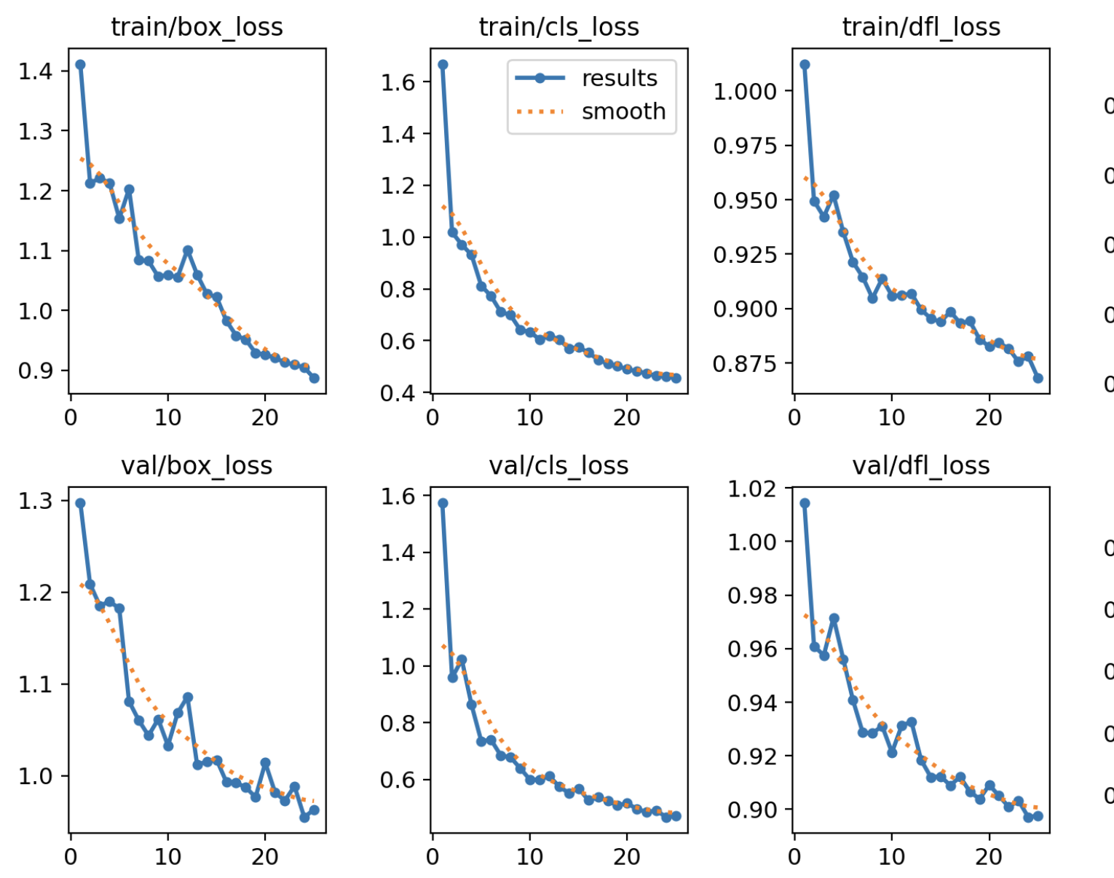
4. Object Detection Loss Terms (part 3 of 5)
Box loss -> how well bounding boxes fit players
Cls_loss -> classification loss (detecting correct class)
Dfl_loss -> Distribution focal loss (localization precision)

Slide 9
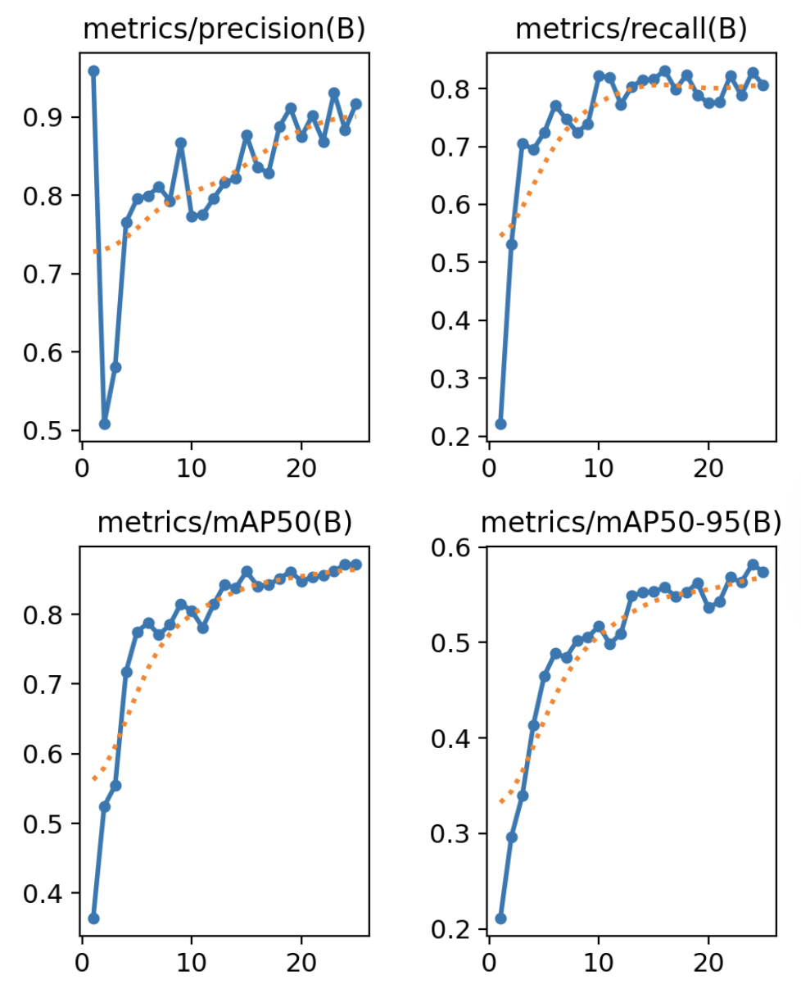
4. Object Detection Validation Metrics (part 4 of 5)
Validation metrics
Precision
Recall
mAP50
mAP50-95
Notes:
Precision (P)
“How many detections were correct?”
High precision = few false positives. Your model has very high precision early on.
Recall (R)
“How many real players did the model find?”
Low recall = many missed detections. In epoch 1, recall was very low (22%), but it improved later.
mAP50
Accuracy when IoU threshold = 0.5. This is the MAIN detection score.
mAP50-95
Average accuracy at IoU thresholds 0.5 → 0.95. Harder metric. Good models are often ~0.5.

Slide 10
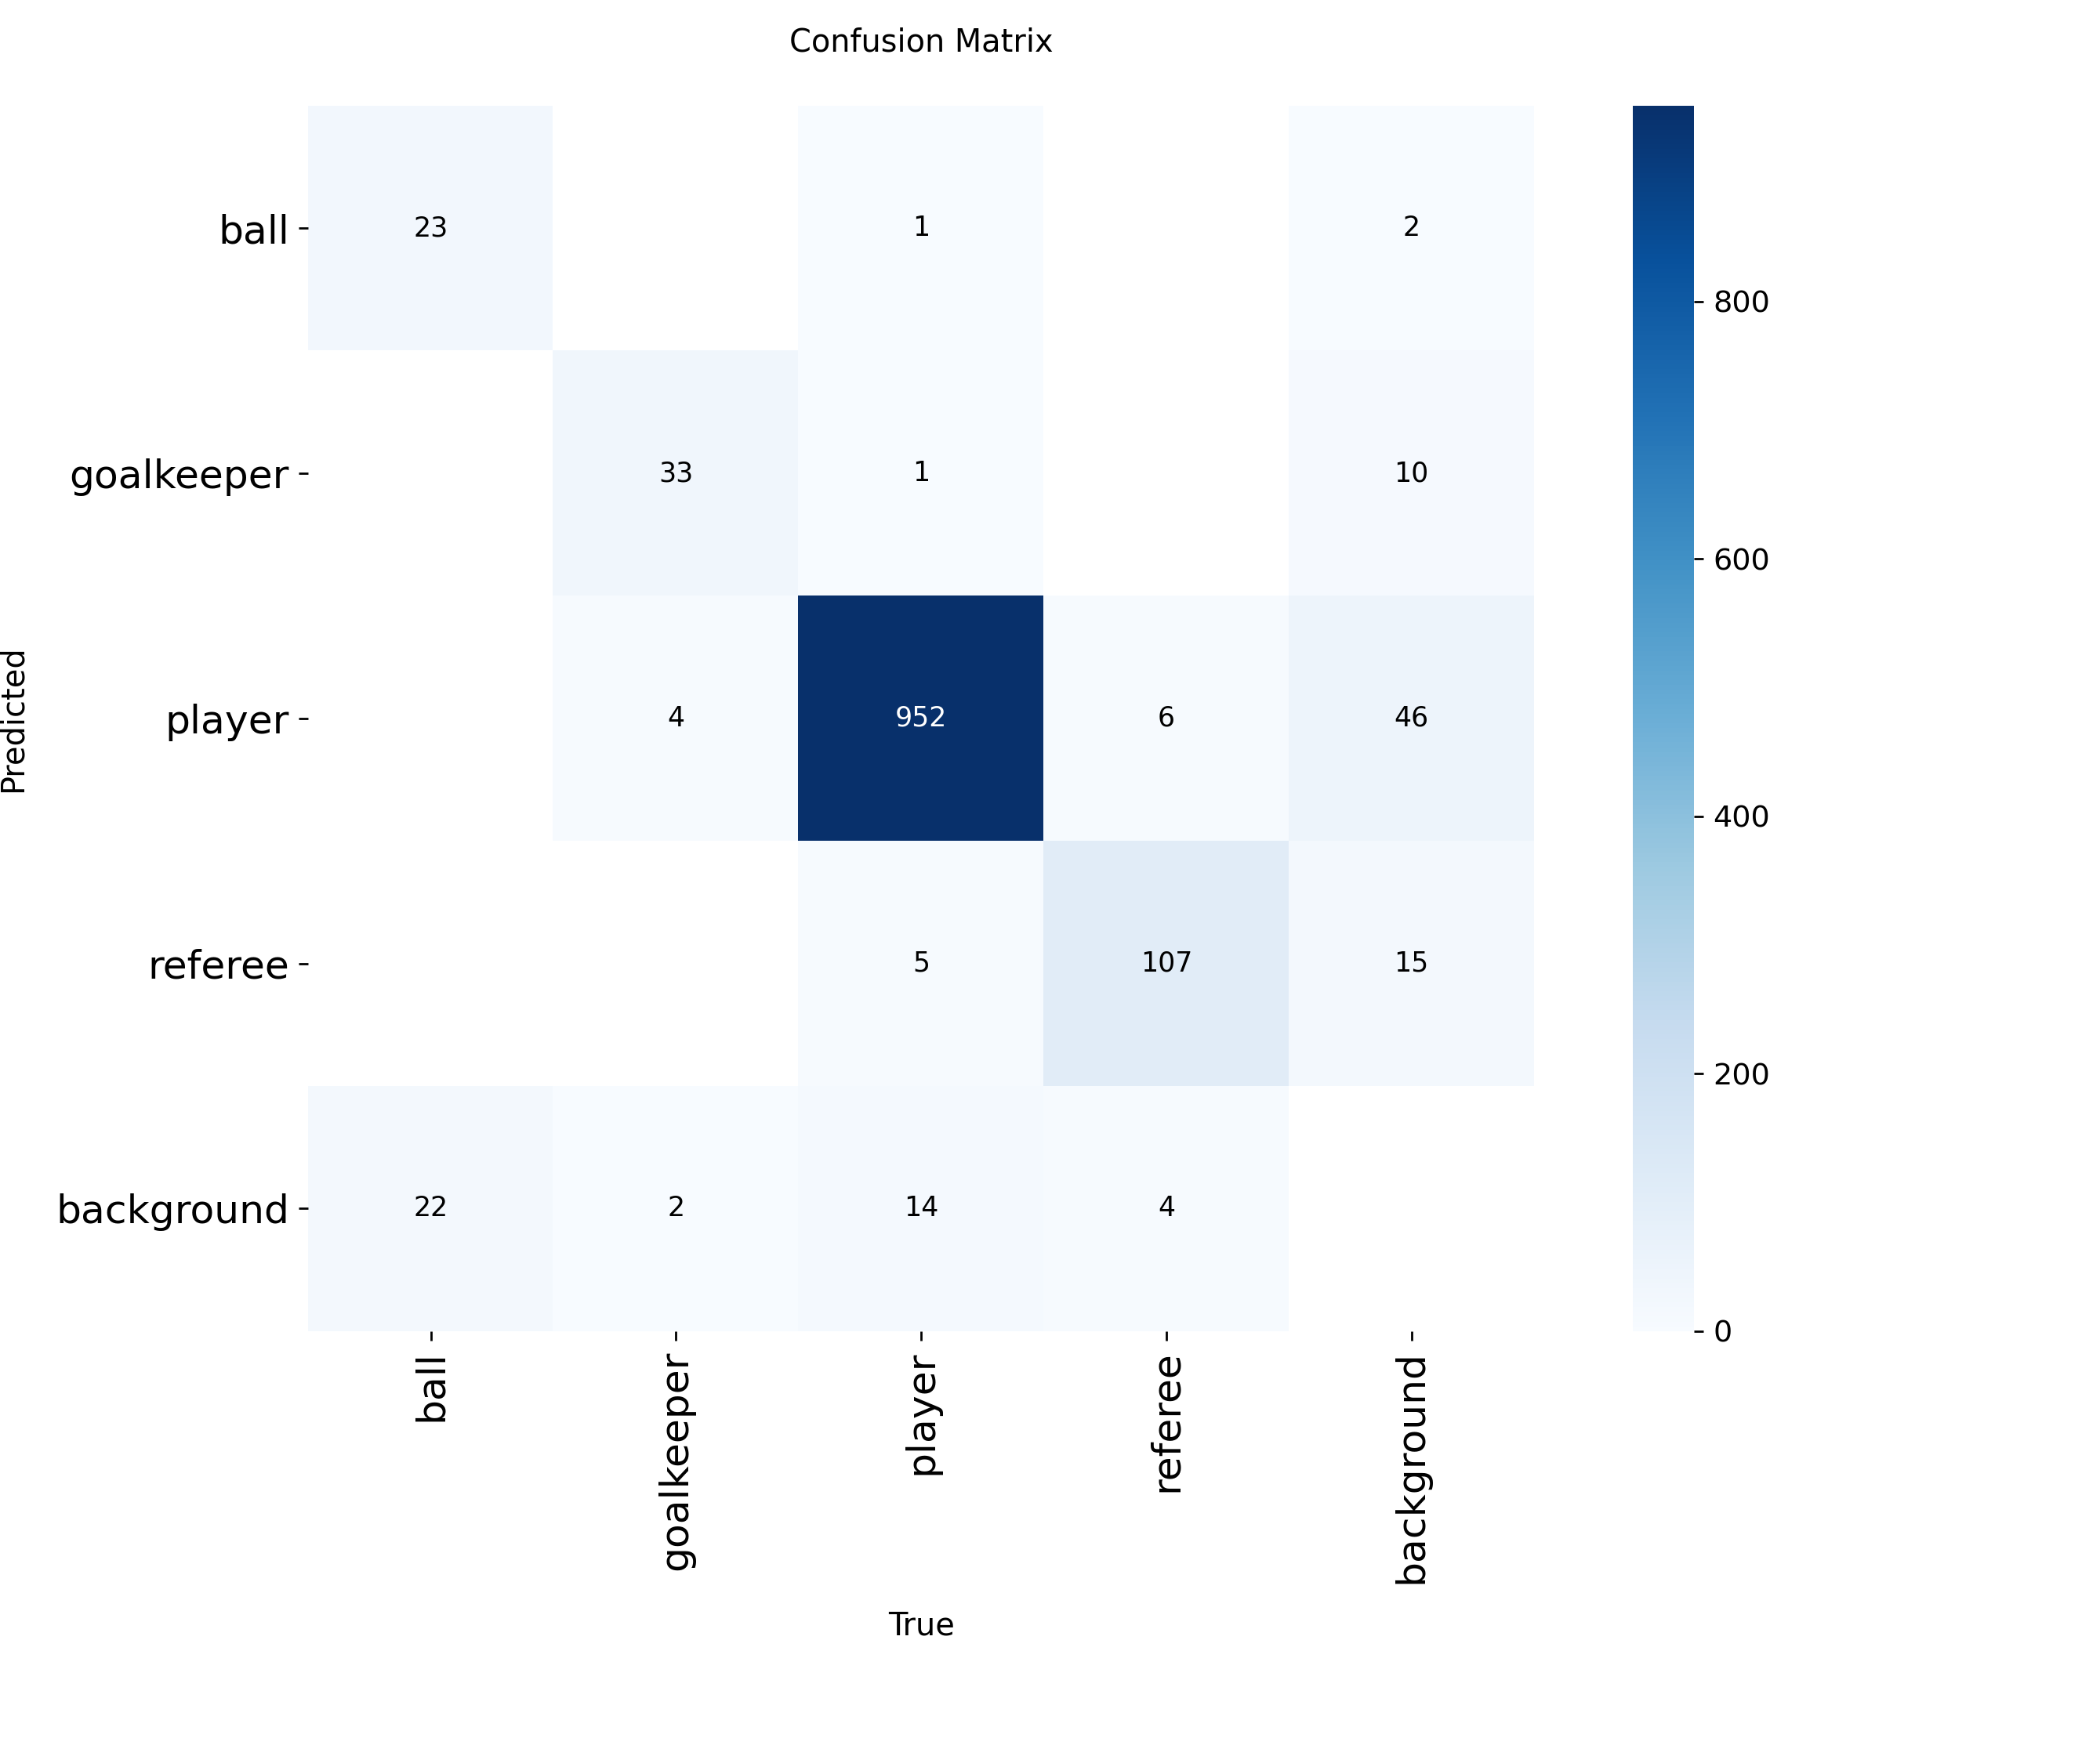
4. Object Detection (part 5 of 5)
Is the model good enough?
mAP50 ~ 0.86
Precision is 0.9
Recall is 0.82
Loss decreases normally

Slide 11
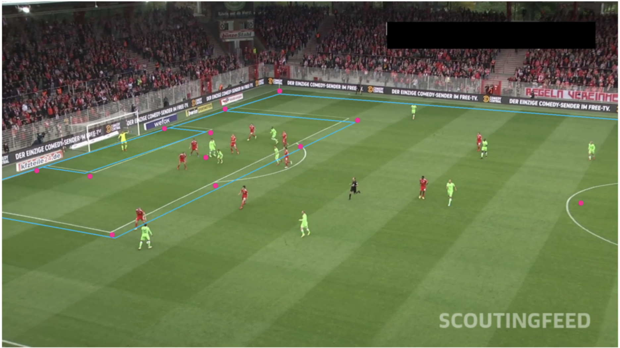
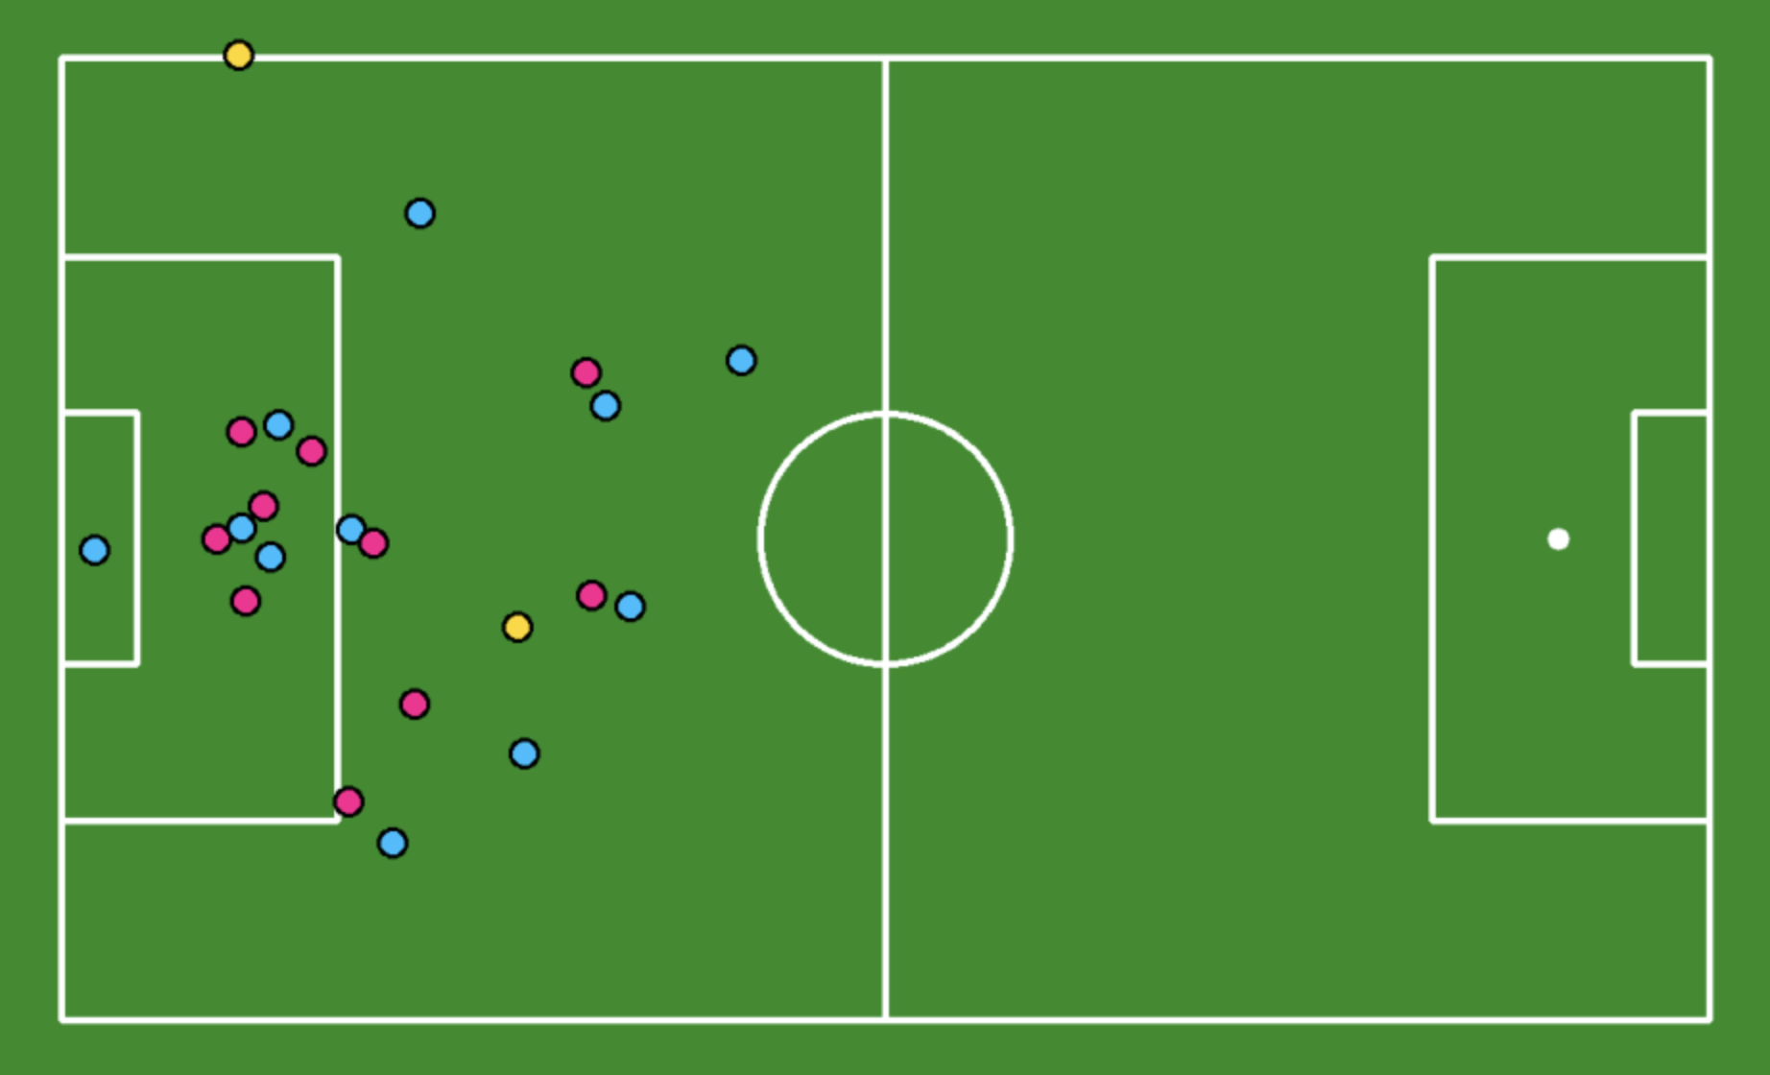
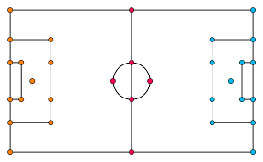
5. Player Tracking & Pitch Mapping
Notes:
ByteTrack algorithm to to assign all objects unique tracker IDs and to track their movement throughout the video.
I used Kmeans to create clusters of players, which is how I divided them by teams

Slide 12
6. Results & Demonstration

Slide 13
7. Limitations & Future Improvements
Limitations
Camera Angle
Jersey IDs
Player re-identification
Future Improvements
Extracting Event Data
Teams Statistics
Individual Statistics
Computing Speed

Slide 14
Smart Soccer Insights
By: Daniel Tshiani
DGT-International
https://DGT-International.com
Thank you!

